Slide 1


MINI PROJECT II
“MEDICAL IMAGE PROCESSING”

Slide 2
GROUP MEMBERS:
Ayushi Rathi (181500184)
Ayushi Srivastava (181500185)
Prashant Chaudhary (181500488)
Rozi (181500595)
Yugam (181500836)

Slide 3
ABOUT THE PROJECT:
Optical Coherence Tomography (OCT) is a fast and non-invasive medical imaging technique which helps in the investigation of each individual retinal layer structure. For early detection of retinal diseases and the study of their progression, segmentation of the OCT images into the distinct layers of the retina plays a crucial role. However, segmentation done by the clinicians manually is extremely tedious, time-consuming and variable with respect to the expertise level. Hence, there is an utmost necessity to develop an automated segmentation algorithm for retinal OCT images which is fast, accurate, and eases clinical decision making.

Slide 4
GOALS OF THIS PROJECT:
The goals for this project are as follows:
To delineate intra-retinal boundaries in retinal SD-OCT images.
To compute retinal layer thicknesses which can be compared to histological thickness values to ease diagnosis of ocular diseases.
To compare the effects of denoising in accurate boundary delineation.
To validate the automated segmentation results by clinical experts.
.

Slide 5
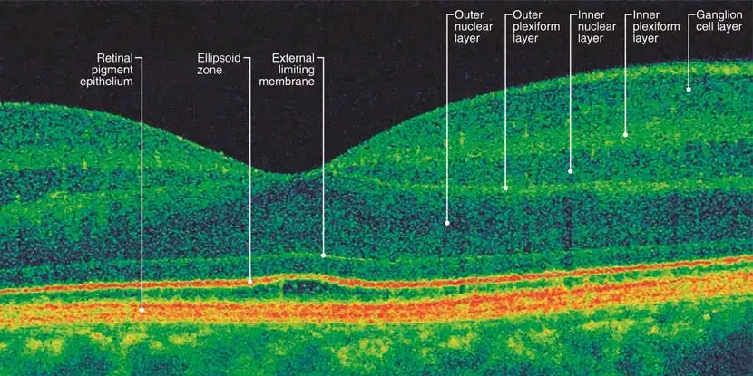
WHAT IS RETINAL IMAGING?
Imaging of the cross-sectional anatomical structures of the retina is necessary for detection, diagnosis and evaluating the effects of therapy for retinal diseases including macular degeneration, glaucoma, and macular edema. There are several ocular imaging techniques for cross-sectional imaging of the eye.

Slide 6
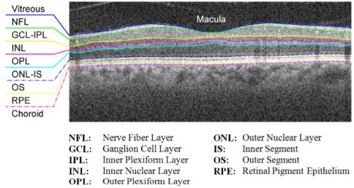
OPTINAL COHERENCE TOMOGRPHY:
Optical coherence tomography (OCT) is a non-invasive medical imaging technique, which is essentially a Michelson interferometer based on the principle of low-coherence interferometry. It works by the determination of magnitude of light intensity that has been reflected off a region of interest within organs such as eye, breast, skin, and kidney.

Slide 7
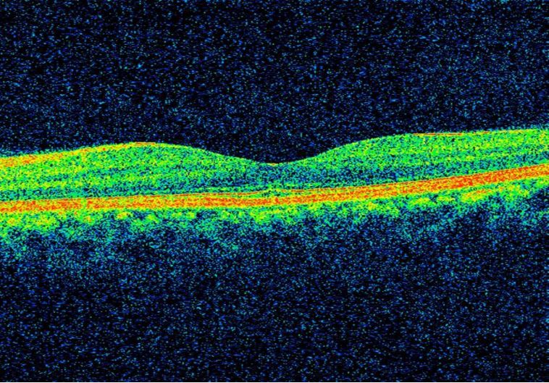
MOTIVATION:
It is driven by the motivation to segment the various layers of retina in an OCT image using graph-theoretical methods to reduce the complexity of computational logic, optimize the processing time, and improve upon accuracy of layer detection.

Slide 8
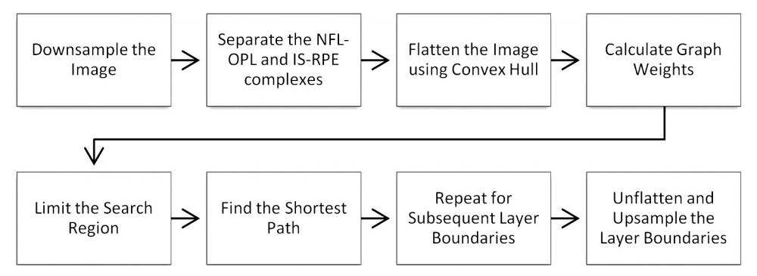
FLOWCHART:

Slide 9
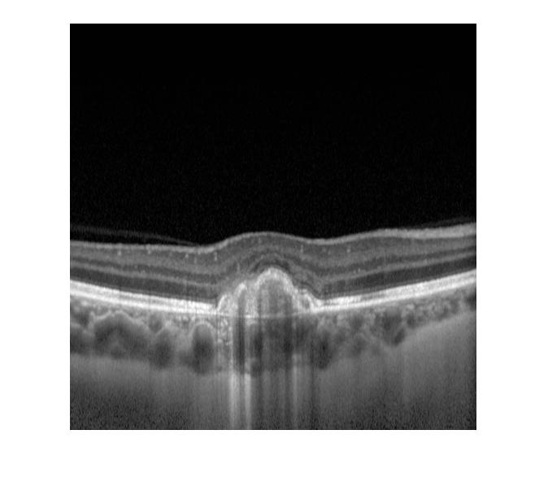
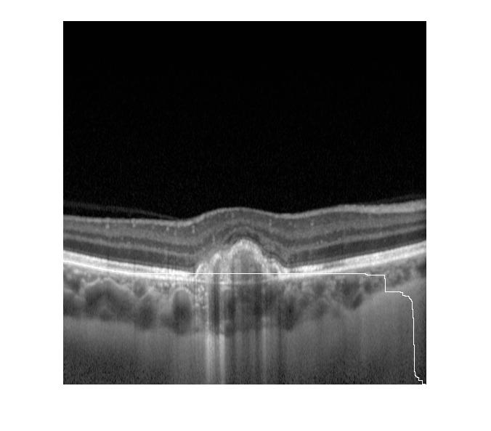
OCT IMAGES OF THE PROJECT:

Slide 10
THANK YOU

